Slide 1

Fried chicken Website Content

Slide 2
Home page Website Content

Slide 3
Slider section
We can’t imagine life without Fried Chicken!
Can you beat the big & spicy pieces?
Treat yourself with the most delicious Fried Chicken

Slide 4
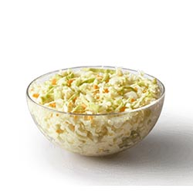
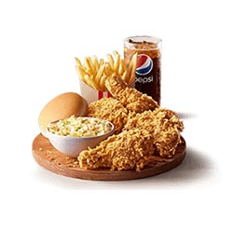
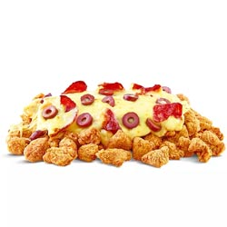
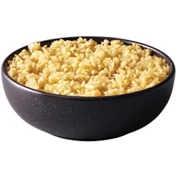
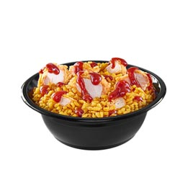
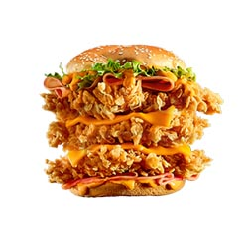
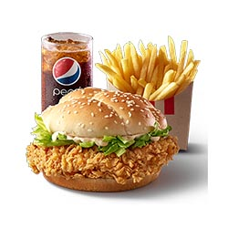
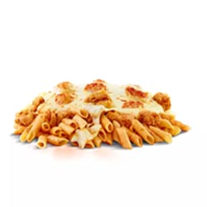
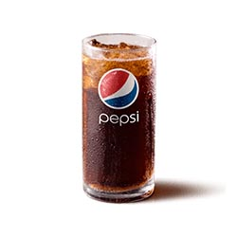
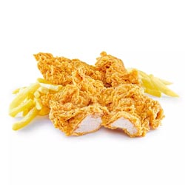
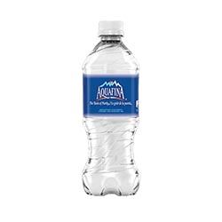
Products
It’s time to order Eat’s Crispy!
Find out our crunchy menu
Category:
Product:
Price:
Appetizers
COLESLAW
Medium: 16 LE – Large 40 LE
Category:
Product:
Price:
Fried Chicken
4 pieces of Chicken + 1 Small Fries + 1 Small Coleslaw + Pepsi + 1 Bun
92 LE
Category:
Product:
Price:
Fried Chicken
Fried Chicken Pizza
59 LE
Category:
Product:
Price:
Fried Chicken
Original Rice
18 LE
Category:
Product:
Price:
Fried Chicken
Fried Chicken Rice
25 LE
Category:
Product:
Price:
Sandwiches
Zinger King sandwich
92 LE
Category:
Product:
Price:
Sandwiches
Spicy Zinger + Fries + Drink
60 LE
Category:
Product:
Price:
Fried Chicken
Fried Chicken Pasta
55 LE
Category:
Product:
Price:
Soft Drinks
Pepsi
20 LE
Category:
Product:
Price:
Fried Chicken
Tender supreme
39 LE
Category:
Product:
Price:
Soft Drinks
Water
10 LE

Slide 5
Banner
My favorite meal has always been fried chicken
We make amazing fried chicken. The secret is our seasoning.
The best comfort food will always be fried chicken
Who don’t love the smell of fried chicken?
Our fried chickens can make you feel better!
Eat’s Crispy is an indispensable part of your day
Let’s enjoy incredibly satisfying meal
In the mood for a crispy food

Slide 6

footer
Eat's Crispy is an EXCEPTIONAL experience of Burgers and Fried Chicken.
Salah Salem St, Heliopolis, Cairo, Egypt
fried@eatscrispy.com
19090

Slide 7
Gallery

Slide 8
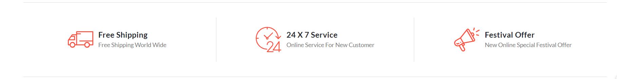
About us
Delivery
To your doorstep
24/7 Fried Chicken
Order whenever you want
Crunchy Offers
Don’t miss our discounts

Slide 9
About page Website Content

Slide 10
About us
An EXCEPTIONAL experience of Burgers and Fried Chicken.
It all began in a food connoisseur’s home kitchen. And from that came the idea for a restaurant where fresh, delicious, wholesome food is cooked for you and your family/friends to order, Whether it’s our signature Burger and fried chicken has given guests something to rave about since the start.
Eat's Crispy doesn’t bring you the tastiest Burgers and Fried Chicken in this city only right now, but we will leave you having a whole new eatery vibe from the first step at the restaurant.

Slide 11





counter
Pieces Served
+14935
Happy Clients
+1854
Locations
1
Staff
+20

Slide 12
Track page Website Content

Slide 13
Track order

Slide 14
Contact page Website Content

Slide 15
Track order

Slide 16


